Slide 1
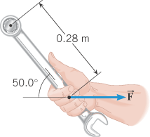
A wrench is used to loosen a nut as shown below.
a. Show the line of action and lever-arm in the diagram.
b. Calculate the lever-arm and torque (Assume F = 15 N).

Slide 2
15. Consider the 12.0 kg motorcycle wheel shown in Figure 10.38. Assume it to be approximately an annular ring with an inner radius of 0.280 m and an outer radius of 0.330 m. The motorcycle is on its center stand, so that the wheel can spin freely. (a) If the drive chain exerts a force of 2200 N at a radius of 5.00 cm, what is the angular acceleration of the wheel? (b) What is the tangential acceleration of a point on the outer edge of the tire? (c) How long, starting from rest, does it take to reach an angular velocity of 80.0 rad/s?

Slide 3
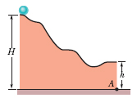
2. In the figure, a solid 0.2 kg ball rolls smoothly from rest (starting at height H = 5.7 m) until it leaves the horizontal section at the end of the track, at height h = 1.8 m. Use the conservation of energy to find the velocity of the ball as it leaves the end of track?

Slide 4
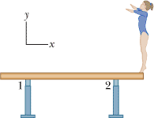
Equilibrium Problem
D. A gymnast with mass 46.0 kg stands on the end of a uniform balance beam as shown below. The beam is 5.00 m long and has a mass of 250 kg (excluding the mass of the two supports). Each support is 0.500 m from its end of the beam. Assume that the forces on the beam due to support 1 and support 2 are vertical. a. Draw a free-body diagram for the beam.
b. Write down a force equation by balancing the forces vertically.
c. Write down a torque equation by balancing the torques.
d. Calculate the forces on the beam due to (a) support 1 and (b) support 2?

Slide 5
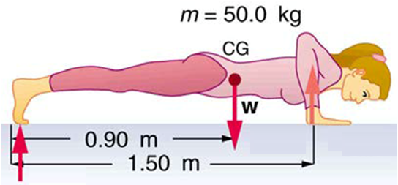
The drawing shows a person doing push-ups. Find the force exerted by the floor on each hand and each foot, assuming that the person holds this position.

